Slide 1
Secure Date hiding images using steganography
CAPSTONE PROJECT
Presented By: Aryan Saini
Student Name : Aryan Saini
College Name & Department : Bhagwan Parshuram Institute of Technology

Slide 2
OUTLINE
Problem Statement
Technology used
Wow factor
End users
Result
Conclusion
Git-hub Link
Future scope

Slide 3
Problem Statement
With rising cybersecurity threats, secure communication is critical. Traditional encryption methods can raise suspicion, whereas steganography allows hidden communication inside images, ensuring secrecy without detection. This project implements image steganography to encode messages securely.

Slide 4
Technology used
– Programming Language: Python – Libraries: OpenCV, TensorFlow, Scikit-learn – Platforms: Python IDLE – Additional Tools: Git for version control

Slide 5
Wow factors
Hides messages in images without altering visible pixels
Password-protected encryption for extra security
Lightweight & fast implementation using OpenCV & NumPy
Can be extended to audio & video steganography

Slide 6
End users
Journalists & Whistleblowers – Secure communication in high-risk environments
Government & Military – Confidential message transmission
Cybersecurity Professionals – Secure data exchange
General Users – Privacy in personal communication

Slide 7
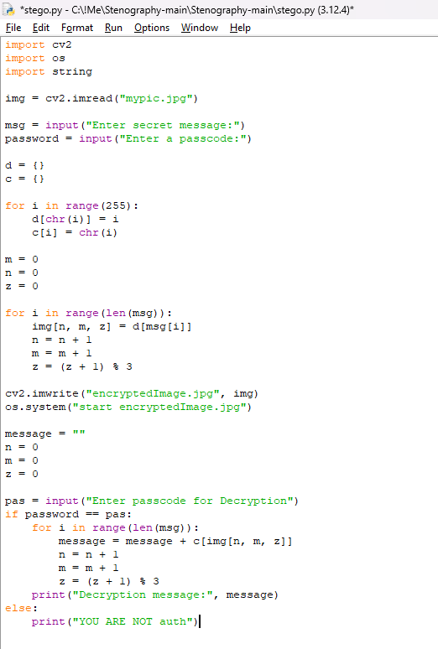
Results

Slide 8
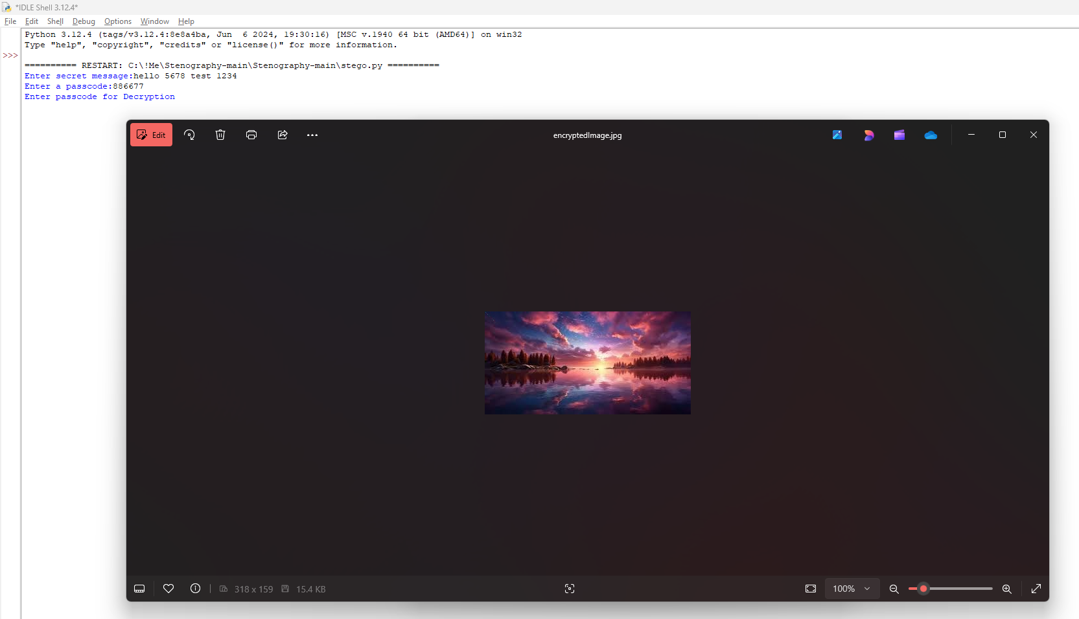

Slide 9
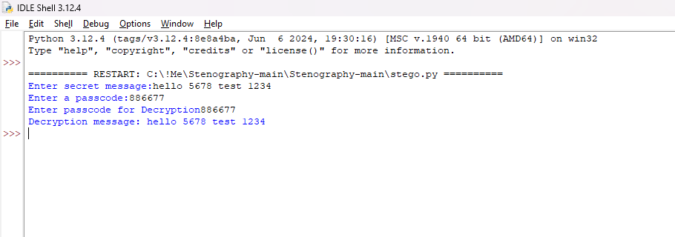
Results

Slide 10
Conclusion
This project successfully implements a steganography-based system for secure communication. It ensures that messages are hidden inside images, invisible to the naked eye while being retrievable with the correct password.

Slide 11
GitHub Link
https://github.com/AryanSaini57/steganography-Project

Slide 12
Future scope
Support for video & audio steganography
AI-based detection of steganographic attacks
Blockchain integration for secure data verification
Mobile app implementation for encrypted communication

Slide 13


